Slide 1
Virtualization of COVID-19
2021/01/18
82%
❗COVID-19

Slide 2
CONTENTS
Background Introduction
Achievement Display
Improvements and Prospects
Contributions of the Group

Slide 3
Background Introduction
01

Slide 4

Background Introduction
The development of the epidemic Covid-19 has made the visualization of epidemic data a hot topic. Creating a platform to publicize the real situation of the domestic epidemic to all audiences can not only remind citizens of the epidemic situation, but also correctly promote the domestic epidemic control situation.
Notes:
流行病Covid-19的发展使流行病数据的可视化成为热门话题。 建立一个向所有听众宣传国内流行病真实情况的平台，不仅可以使公民了解流行病的情况，而且可以正确地促进国内流行病的控制。

Slide 5
Achievement Display
02

Slide 6
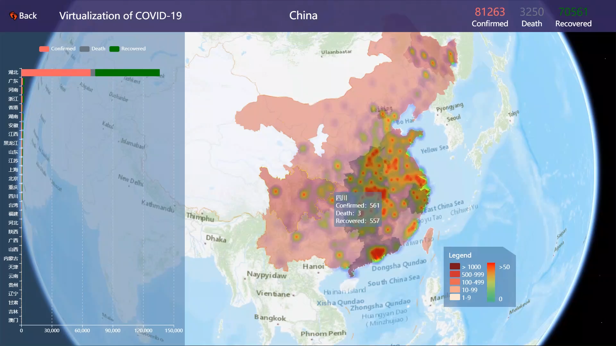
Achievement Display

Slide 7
Improvements and Prospects
03

Slide 8
Improvements and Prospects
From the analysis of the epidemic situation from China to the world, we can achieve a visual analysis of all of the countries in the world.
Perform visual analysis from the time dimension to achieve a better understanding and analysis of the overall timeline of large-scale public health events in the post-epidemic era.
Notes:
流行病Covid-19的发展使流行病数据的可视化成为热门话题。 建立一个向所有听众宣传国内流行病真实情况的平台，不仅可以使公民了解流行病的情况，而且可以正确地促进国内流行病的控制。

Slide 9
Contributions of the Group
04

Slide 10
Contributions of the Group
 | Epidemic distribution map, Operations of Bar Graph, Html+css5 web page : overview, services, Slides
 | Epidemic heat map, Operations of of Bar Graph, Html+css5 webpage : treatment, prevention, Demonstration videos
Notes:
jsc：疫情分布图相关工作、条形图图例和tooltips等相关操作的实现、html+css5网页overview、services的实现以及跳转、ppt制作
tsz：流行病热图相关工作，
条形图的相关实现，
实施html + css5网页处理，预防和录制演示视频

Slide 11
For our country, for our world.
Thanks.

